Slide 1
PIZZA SALES ANALYSIS USING SQL
Project Overview & Database Structure
Analyse pizza sales data to understand customer preferences and sales performance.
Identify top-selling pizzas, revenue trends, and category performance.
OBJECTIVE
DATASET OVERVIEW
4 relational tables linked using SQL JOINs
21,350 customer orders analysed
Sales, category, size, and pricing data examined.
Orders
(order_id, order_date, order_time)
Order Details
(order_details_id, order_id, pizza_id, quantity)
Pizzas
(pizza_id, pizza_type_id, size, price)
Pizza Types
(pizza_type_id, name, category)

Slide 2

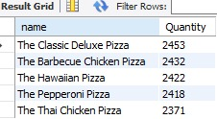
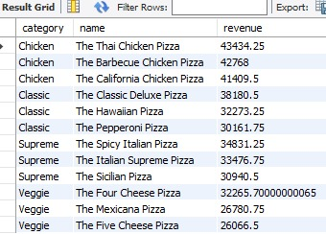
SQL Analysis & Methodology
SQL CONCEPTS USED
REVENUE ANALYSIS
SQL concepts used
Data extraction using SELECT statements
Table relationships using JOINs
Data summarization using aggregate functions
Business reporting using GROUP BY
Sorting and ranking results using ORDER BY
TOP SELLING PIZZAS
BUSINESS QUESTIONS ANSWERED
CATEGORY-WISE SALES
Total orders placed
Total revenue generated
Most common pizza size
Top-selling pizzas
Category-wise sales
Revenue contribution analysis

Slide 3
Sales Performance & Key Metrics
KEY PERFORMANCE INDICATORS (KPIs)
PERCENTAGE CONTRIBUTION
Total Orders
21,350
Insight:
Represents the total number of customer orders analysed during the study period.
Total Revenue
$817,860
Insight:
Total sales generated from pizza orders, highlighting overall business performance.
QUANTITY SOLD
Most ordered pizza size
Large
18,526 orders
Insight:
Large-sized pizzas were the most preferred choice among customers
Highest sales category
Classic
14,888 units sold
Insight:
Classic pizzas contributed the highest sales volume across all categories.

Slide 4
Business Insights & Recommendations
KEY INSIGHTS
BUSINESS RECOMMENDATIONS
The business processed 21,350 orders and generated $817,860 in total revenue.
Large-sized pizzas were the most preferred choice among customers.
The classic category recorded the highest quantity sold.
Premium pizzas generated higher revenue despite lower order volumes.
Customer demand was concentrated around a few popular products.
Maintain higher inventory levels for top-selling pizzas.
Introduce combo offers featuring best-selling products.
Promote low-performing pizzas through discounts and bundle deals.
Focus marketing efforts on the most profitable categories.
Use sales insights to improve inventory planning and reduce wastage.
CONCLUSION
This project demonstrates how SQL can be used to transform raw transactional data into actionable business insights. The analysis helped identify customer preferences, product performance, and revenue trends that can support strategic decision-making.

